Slide 1

SyriaTel Churn Analysis
Carrie Liu
December 27, 2021

Slide 2
CONTENT
Overview
Our Approach
Primary Determinants of Churn
Recommendations

Slide 3
OVERVIEW
SyriaTel, a telecommunication company with customers across the United States.
It is suffering from a loss of valuable customers to competitors.
Our team is hired to build a classification model and determine the primary features that lead to the churn of customers.
The datasets include 3333 customers in 51 states (including D.C.) on a monthly basis.

Slide 4
Perform exploratory data analysis on current data
Build up baseline model using logistic regression
Apply multiple machine learning algorithms to build the best classification model
Find the primary determinants of churn
OUR APPROACH

Slide 5




PRIMARY DETERMINANTS
Customer Service Calls
Total Day Minutes
International Plan and Voice Mail Plan
Monthly Charges

Slide 6
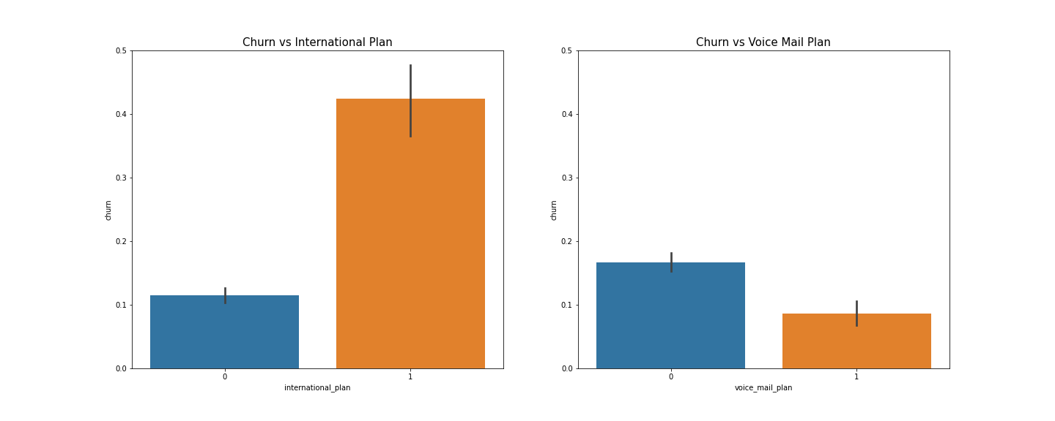
INTL PLAN & VOICE MAIL PLAN

Slide 7
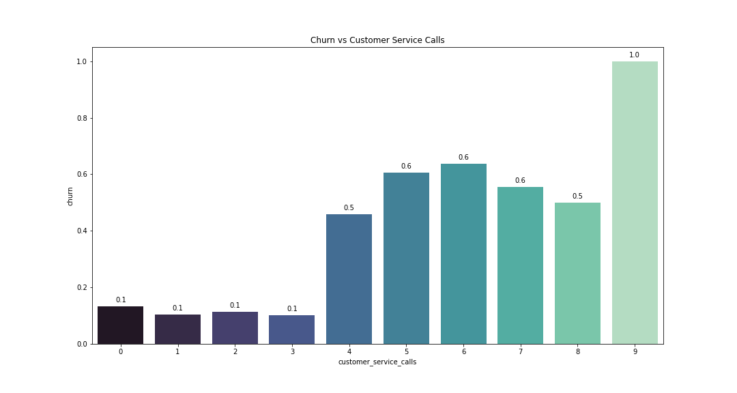
CUSTOMER SERVICE CALLS

Slide 8
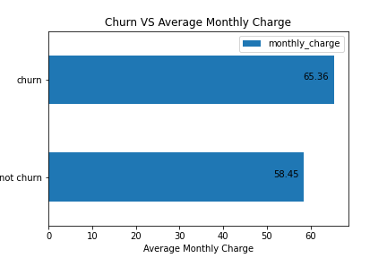
MONTHLY CHARGE
Monthly Charge
= Total Day Charge
+ Total Eve Charge
+ Total Night Charge
+ Total Intl Charge
Average Monthly Charge = $59.5
Max Monthly Charge = $96.2
Min Monthly Charge = $22.9

Slide 9
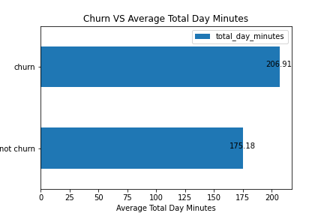
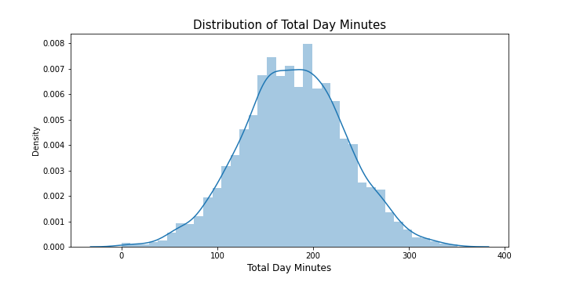
TOTAL DAY MINUTES

Slide 10
RECOMMENDATIONS
Market research on competitors and industry benchmark
Customer experience measurement and design
Partnership with local carriers

Slide 11
Thank you!

